Slide 1
Full Stack Java Developer: Capstone Project

Slide 2
Capstone Project: Introduction
Capstone project is a comprehensive project that aims to deliver end-to-end functionality of a business application.
Multiple technologies
Every stage of a capstone project can be implemented with different services present for the operations.
2
Scalable
Due to its dynamic nature, it is built around various domains and business use cases which make it scalable.
Capstone
Multi-level
Multi-level projects are used to deploy on the cloud.
1
3

Slide 3
Project Development Flow
Agile planning
Database management
Frontend
1
3
5
2
4
6
Project delivery divided into sprints
Backend
DevOps and testing

Slide 4
Technologies
Database Management
MySQL, Oracle, and MongoDB
Backend Development
Java Programming, JPA, Hibernate, and Servlets
Frontend Development
JSP, Angular, Bootstrap, HTML/CSS, Javascript, and NodeJS
Testing and DevOps
Selenium, TestNG, Jenkins, GitHub, Docker, and AWS

Slide 5
Domain: Healthcare

Slide 6
Domain: Healthcare
Project Objective:
Create a dynamic and responsive Java e-healthcare web application for online ordering of medicines.
Background of the project:
Medicare is a company that supplies medicines and a couple of other healthcare essentials at an affordable price. It was established in 2012 in Delhi, India.
It had been serving fine all these years, however, the business analysts noticed a drop in the selling since 2015. They found out that online ordering of medicines with companies, such as 100mg and mfine are gaining more profits by eliminating middlemen from the equation. As a result, the team decided to hire a Full Stack developer who could develop a healthcare web application with a rich and user-friendly interface.
You are hired as the Full Stack Java developer and are asked to develop the web application. The management team has provided you with the requirements and their business model so that you can easily arrange different components of the application.

Slide 7


Admin Portal Features
Below are the key responsibilities and functionalities to be implemented in the admin portal. The admin user should be able to:
Add or remove medicine details from the application to build a rich product line
Edit medicine details like name, price, seller, and description to keep the product information updated with the current prices
Administrator
Enable or disable the medicines

Slide 8

User Portal Features
Below are the key responsibilities and functionalities to be implemented in the user portal. The end user must be able to:
Sign in to the application to maintain the record of activities
Search for products based on the search keyword
User Portal
Apply filters and sort results based on different categories

Slide 9
User Portal Features
Below are the key responsibilities and functionalities to be implemented in the user portal. The end user must be able to:
Add all the selected products and customize the purchase at the end
Experience a seamless payment process
User Portal
Receive an order summary page once the payment is complete

Slide 10
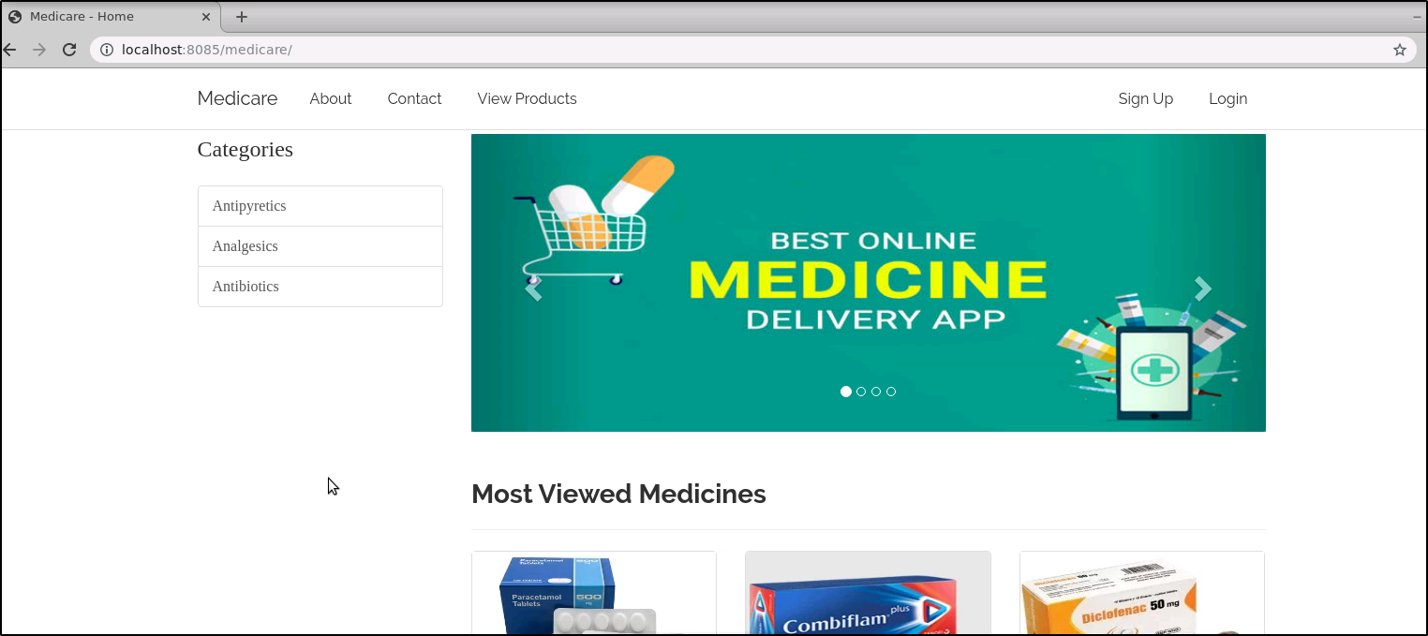
Project Reference Outputs

Slide 11
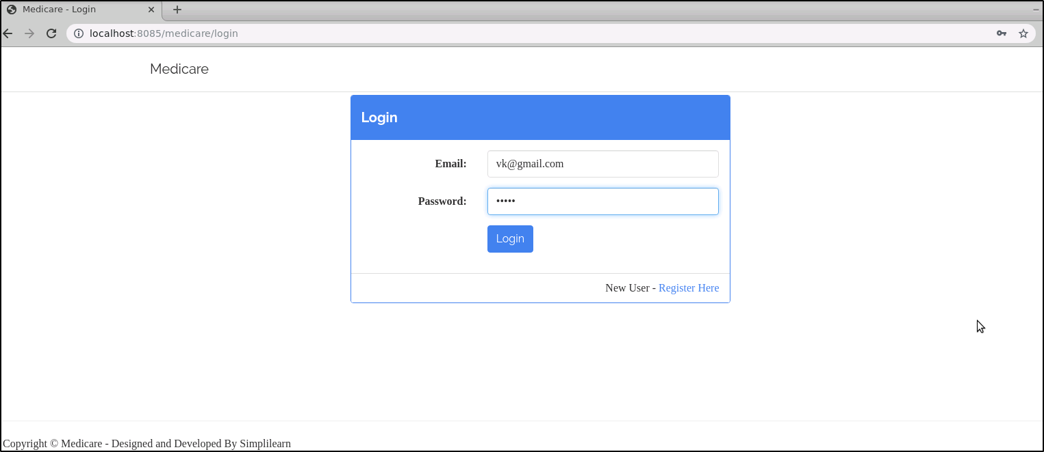
Project Reference Outputs

Slide 12
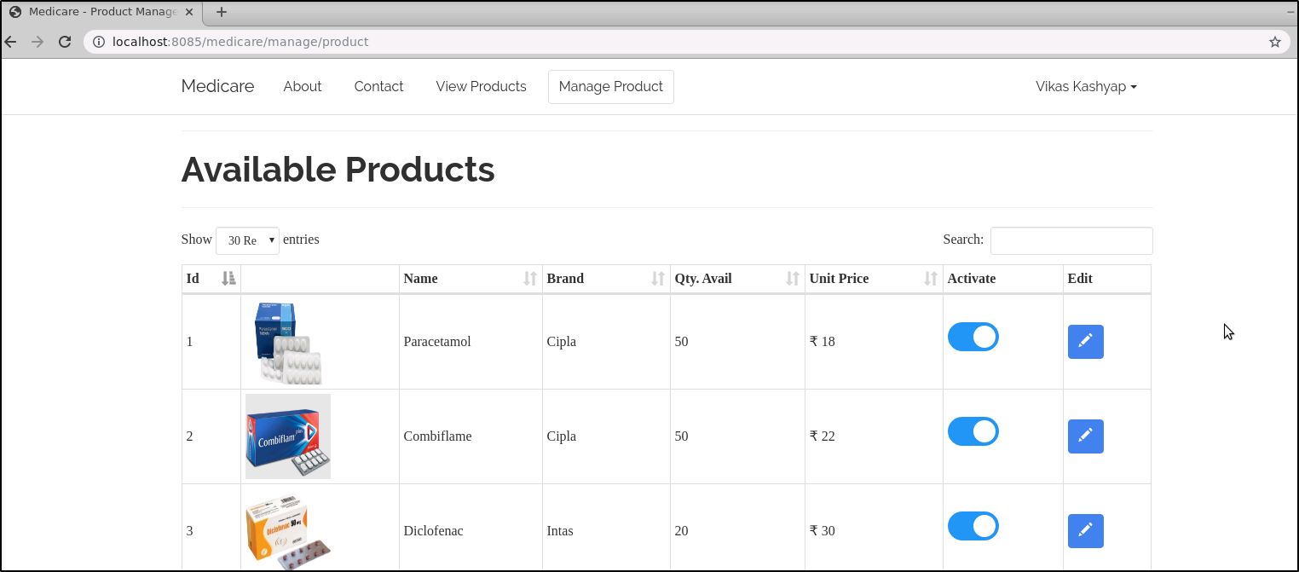
Project Reference Outputs

Slide 13
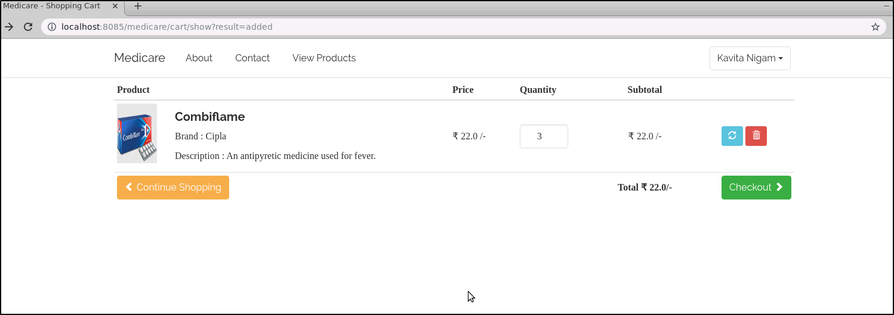
Project Reference Outputs

Slide 14
Domain: Food Delivery

Slide 15
Domain: Food Delivery
Project Objective:
Create a dynamic and responsive online food delivery web application for ordering food items
of different cuisines from a restaurant.
Background of the project:
Foodbox is a restaurant chain that delivers food items of different cuisines at affordable prices.
It was established in 2014 in Bengaluru, India.
It had been serving fine all these years, however, the business analysts noticed a decline in sales since 2016. They found out that online ordering of food items with companies, such as Swiggy and Foodpanda are gaining more profits by eliminating middlemen from the equation. As a result, the team decided to hire a Full Stack developer to develop an online food delivery web application with a rich and user-friendly interface.
You are hired as the Full Stack Java developer and are asked to develop the web application.
The management team has provided you with the requirements and their business model so
that you can easily arrange different components of the application.

Slide 16
Admin Portal Features
Below are the key responsibilities and functionalities to be implemented in the admin portal. The admin user should be able to:
Add or remove cuisines to or from the application to build a rich product line
Edit food item details like name, price, cuisine, description, and offers to keep it aligned to the current prices
Administrator
Enable or disable the food items

Slide 17
User Portal Features
Below are the key responsibilities and functionalities to be implemented in the user portal. The end user must be able to:
Sign in to the application to maintain the record of activities
Search for food items based on the search keyword
User Portal
Apply filters and sort results based on different cuisines to get the best deals

Slide 18
User Portal Features
Below are the key responsibilities and functionalities to be implemented in the user portal. The end user must be able to:
Add all the selected food items to a cart and customize the purchase at the end
Perform a seamless payment process
User Portal
Get an order summary details page once the payment is complete

Slide 19
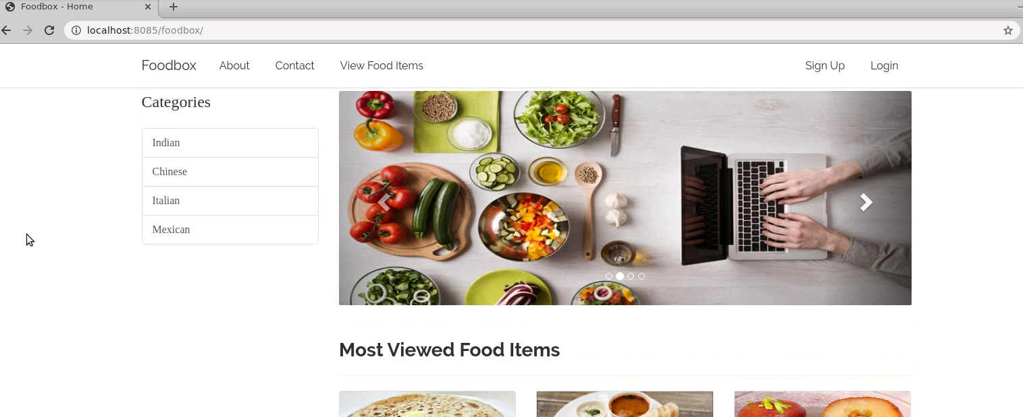
Project Reference Outputs

Slide 20
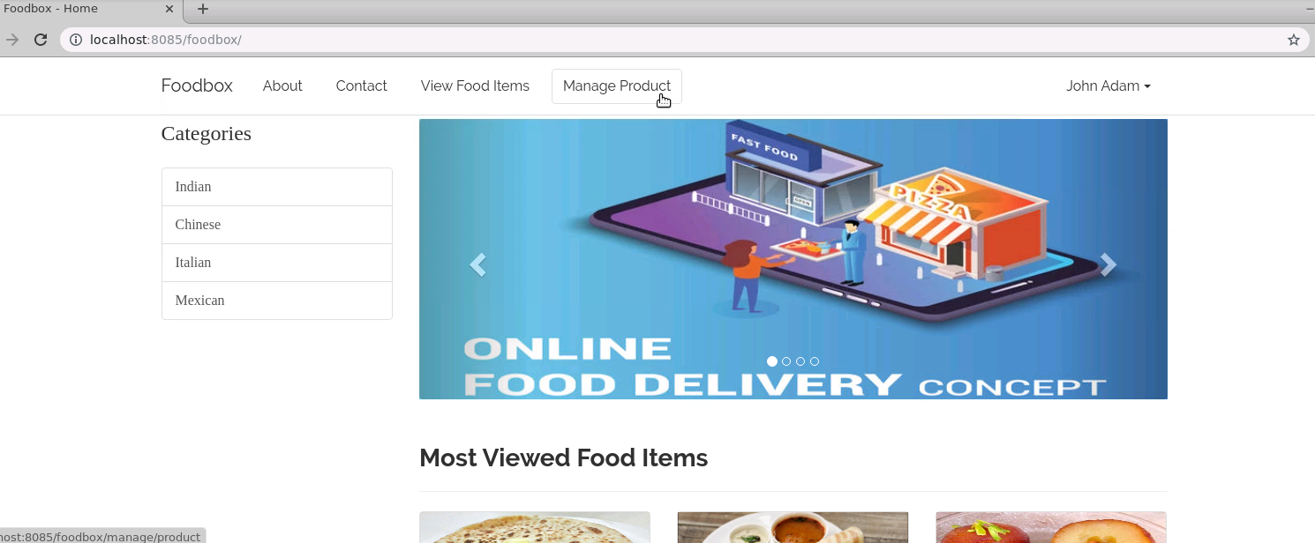
Project Reference Outputs

Slide 21
Domain: Entertainment

Slide 22
Domain: Entertainment
Project Objective:
Create a dynamic and responsive web application for booking movie tickets online for different genres and languages.
Background of the project:
NMS Cinemas is a chain of single screen theatres that screen movie shows of different genres and languages at very genuine prices.
It was established in 2004 in Pune, India. Recently, the business analysts noticed a decline in sales since 2010. They found out that the online booking of movie tickets from apps, such as BookMyShow and Paytm were gaining more profit by eliminating middlemen from the equation. As a result, the team decided to hire a Full Stack developer to develop an online movie ticket booking web application with a rich and user-friendly interface.
You are hired as the Full Stack Java developer and are asked to develop the web application. The management team has provided you with the requirements and their business model so that you can easily arrange different components of the application.

Slide 23
Admin Portal Features
Below are the key responsibilities and functionalities to be implemented in the admin portal. The admin user should be able to:
Add or remove different genres to or from the application to build a rich product line
Edit movie details like name, ticket price, language, description, and show timings to keep it aligned to the current prices
Administrator
Enable or disable movie shows from the application

Slide 24
User Portal Features
Below are the key responsibilities and functionalities to be implemented in the user portal. The end user must be able to:
Sign in to the application to maintain a record of activities
Search for movie tickets based on the search keyword
User Portal
Apply filters and sort results based on different genres

Slide 25
User Portal Features
Below are the key responsibilities and functionalities to be implemented in the user portal. The end user must be able to:
Add all the selected movie tickets to a cart and customize the purchase at the end
Experience a seamless payment process
User Portal
Receive a booking summary page once the payment is complete

Slide 26
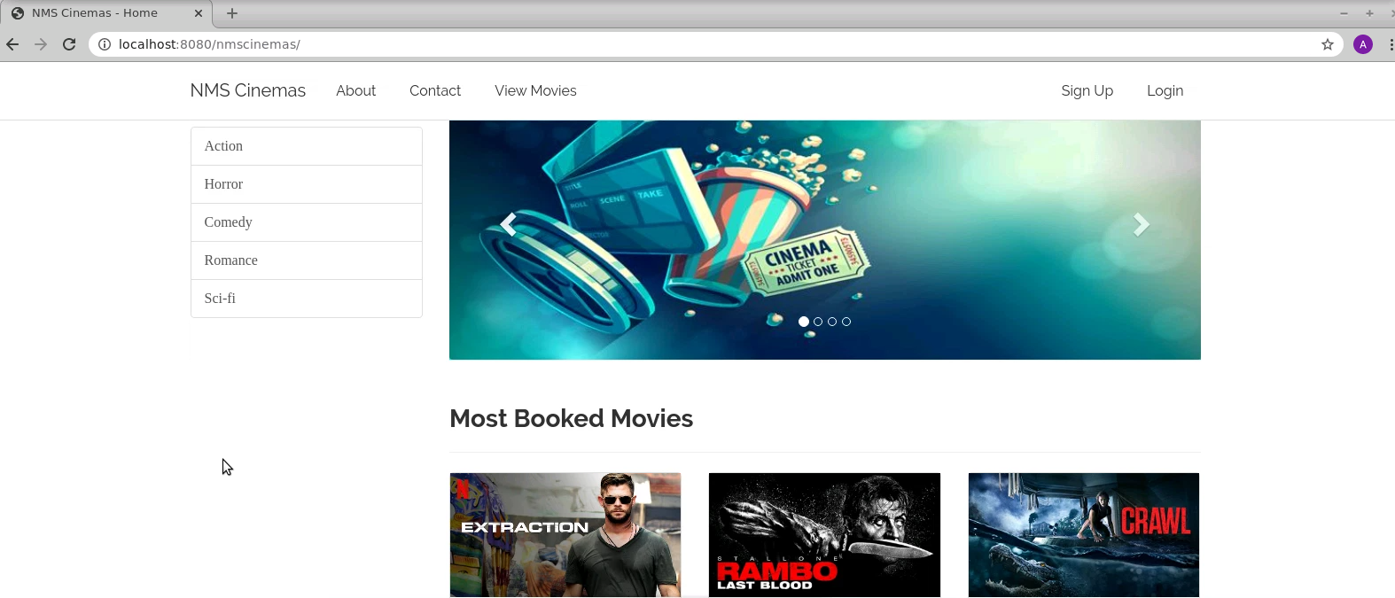
Project Reference Outputs

Slide 27
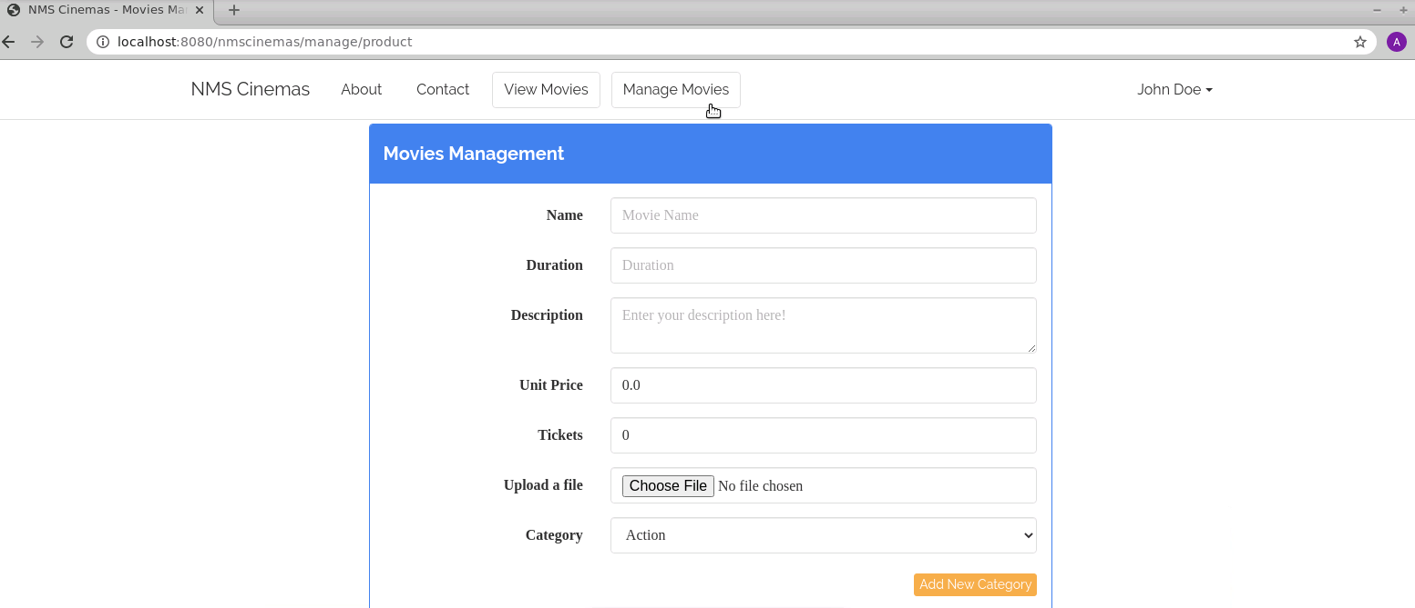
Project Reference Outputs

Slide 28
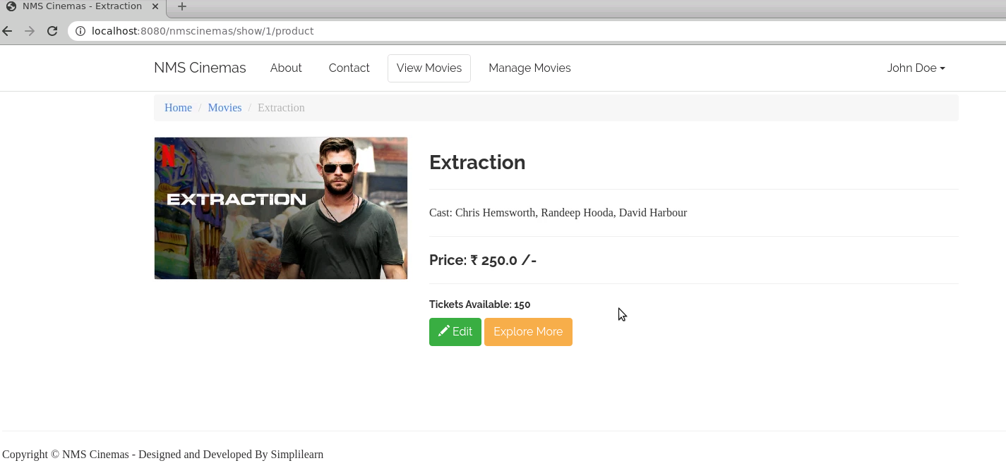
Project Reference Outputs

Slide 29
Domain: Online Banking

Slide 30
Domain: Online Banking
Project Objective:
Create a dynamic and responsive Java online banking web application to deposit, withdraw, and transfer money between accounts.
Background of the project:
ICIN is one of the top banking firms that accepts deposits from the public for the purpose of lending loans to the public. It also invests an amount in securities.
Recently, the business analysts noticed a drop in the number of customers of the bank. They found out that online banking systems of banks like AXIS and American Express are gaining more profits by eliminating middlemen from the equation. As a result, the team decided to hire a Full Stack developer who can develop an online banking web application with a rich and user-friendly interface.
You are hired as one of the Full Stack Java developers and have been asked to develop the web application. The management team has provided you with the requirements and their business model so that you can easily arrange different components of the application.

Slide 31
Admin Portal Features
Below are the key functionalities to be implemented in the admin portal. The admin should be able to:
Authorize the roles and guidelines for the user
Grant access to the user regarding money transfer, deposits, and withdrawal
Administrator
Block a user account in case of any threat and authorize cheque book requests

Slide 32
User Portal Features
Below are the key functionalities to be implemented in the user portal. The end user should be able to:
Register or log in to the application to maintain a record of activities
Deposit and withdraw money from the account
View the balance in their primary and savings account
User Portal
Transfer funds between different accounts and add recipients
Cheque book requests for different accounts

Slide 33
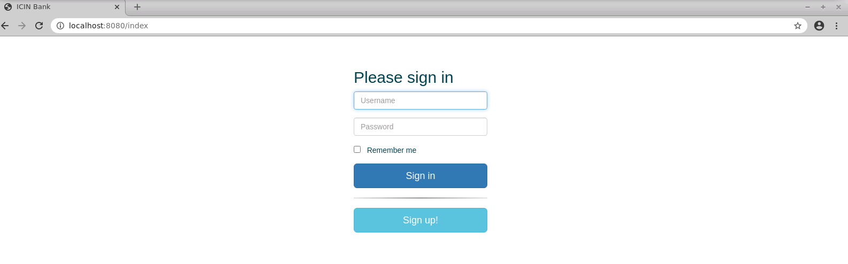
Project Reference Outputs

Slide 34
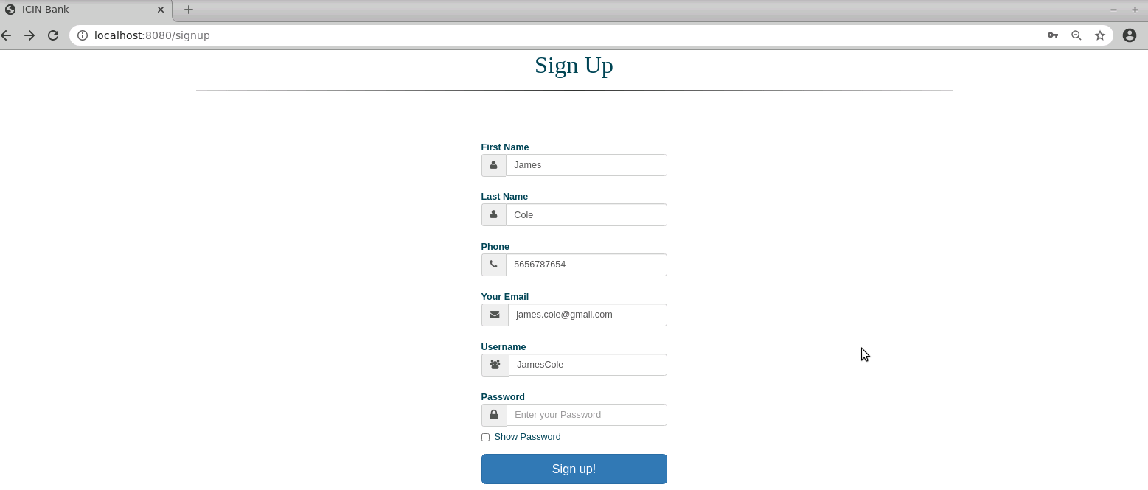
Project Reference Outputs

Slide 35
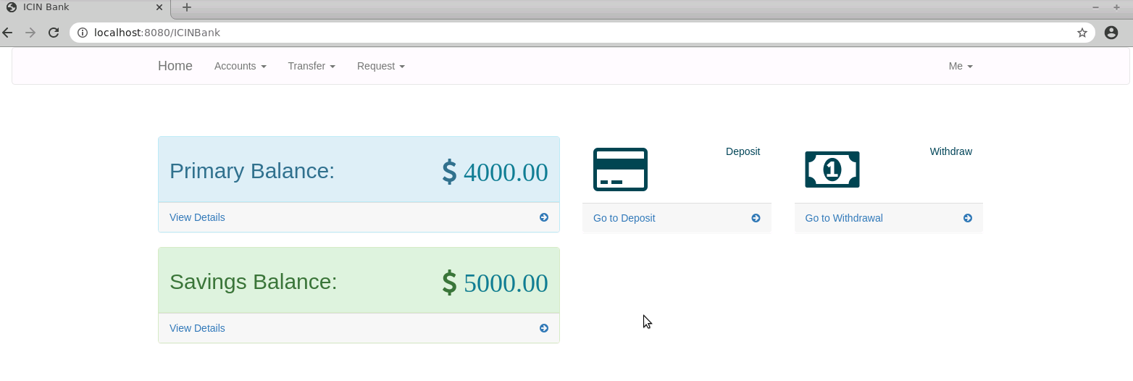
Project Reference Outputs

Slide 36
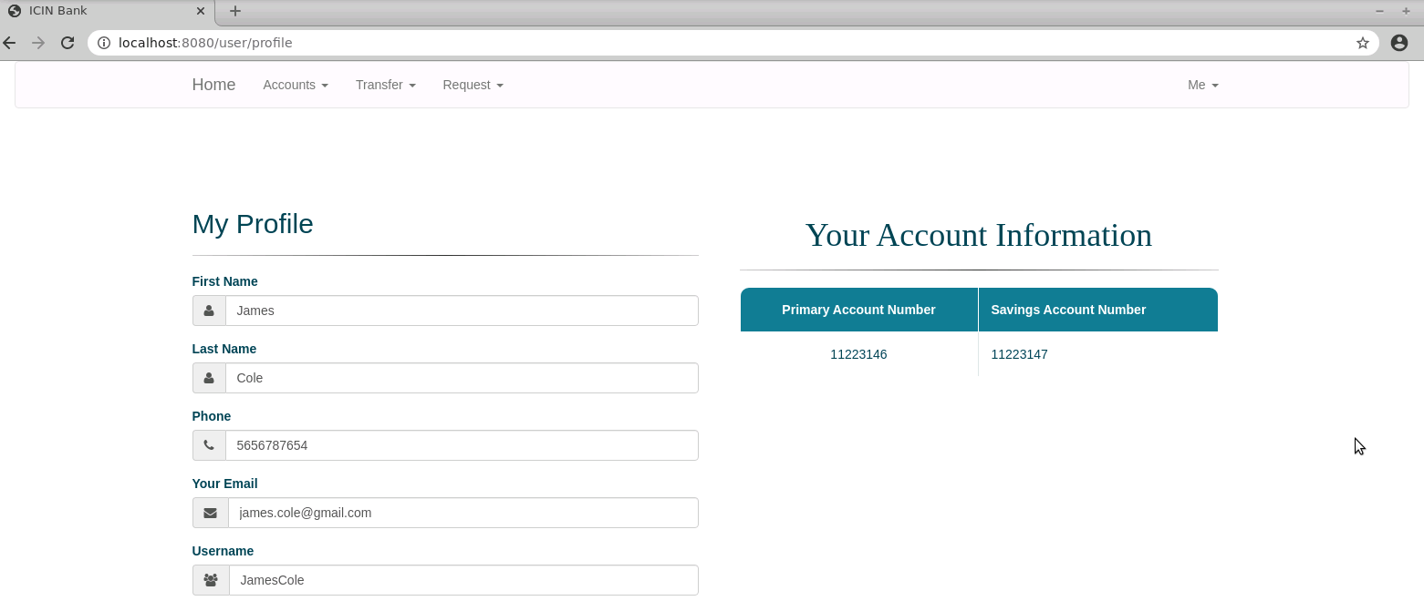
Project Reference Outputs

Slide 37
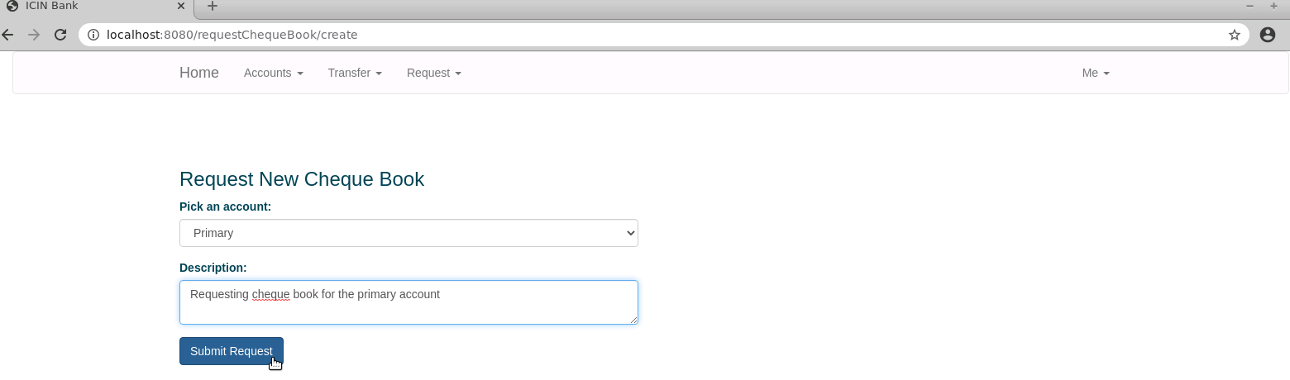
Project Reference Outputs

Slide 38
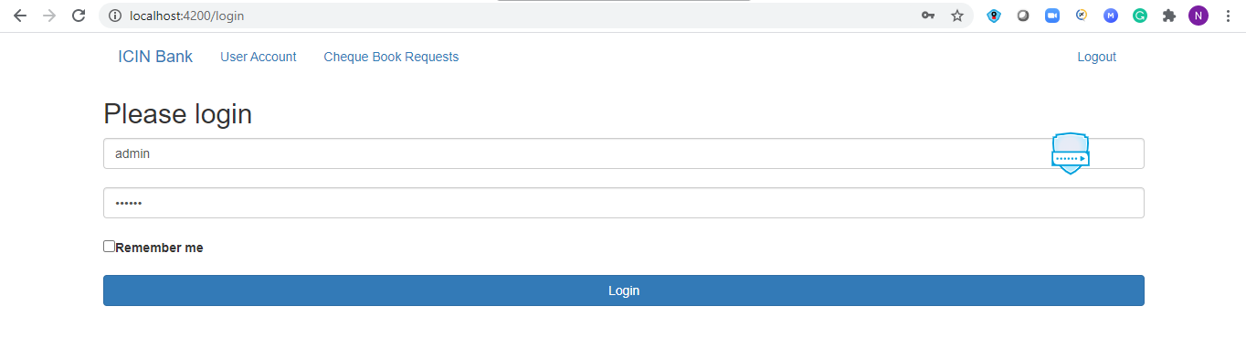
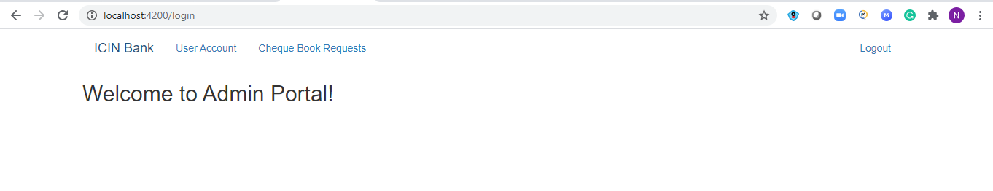
Project Reference Outputs

Slide 39
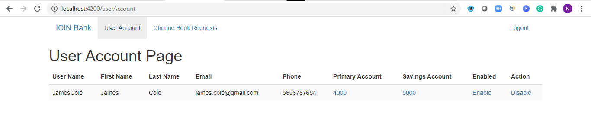
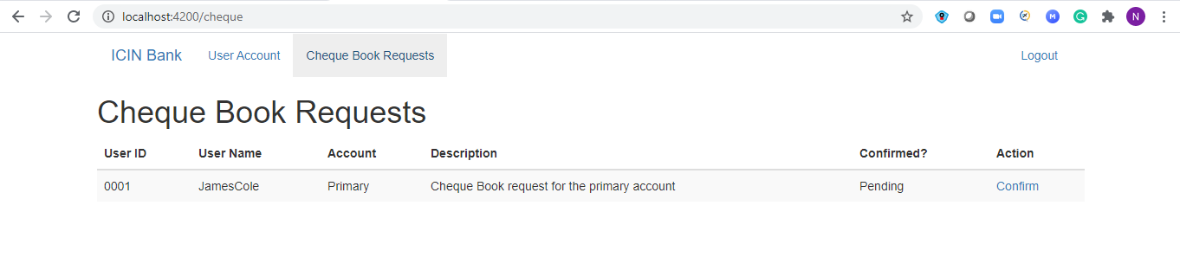
Project Reference Outputs

Slide 40
Thank You

